Slide 1



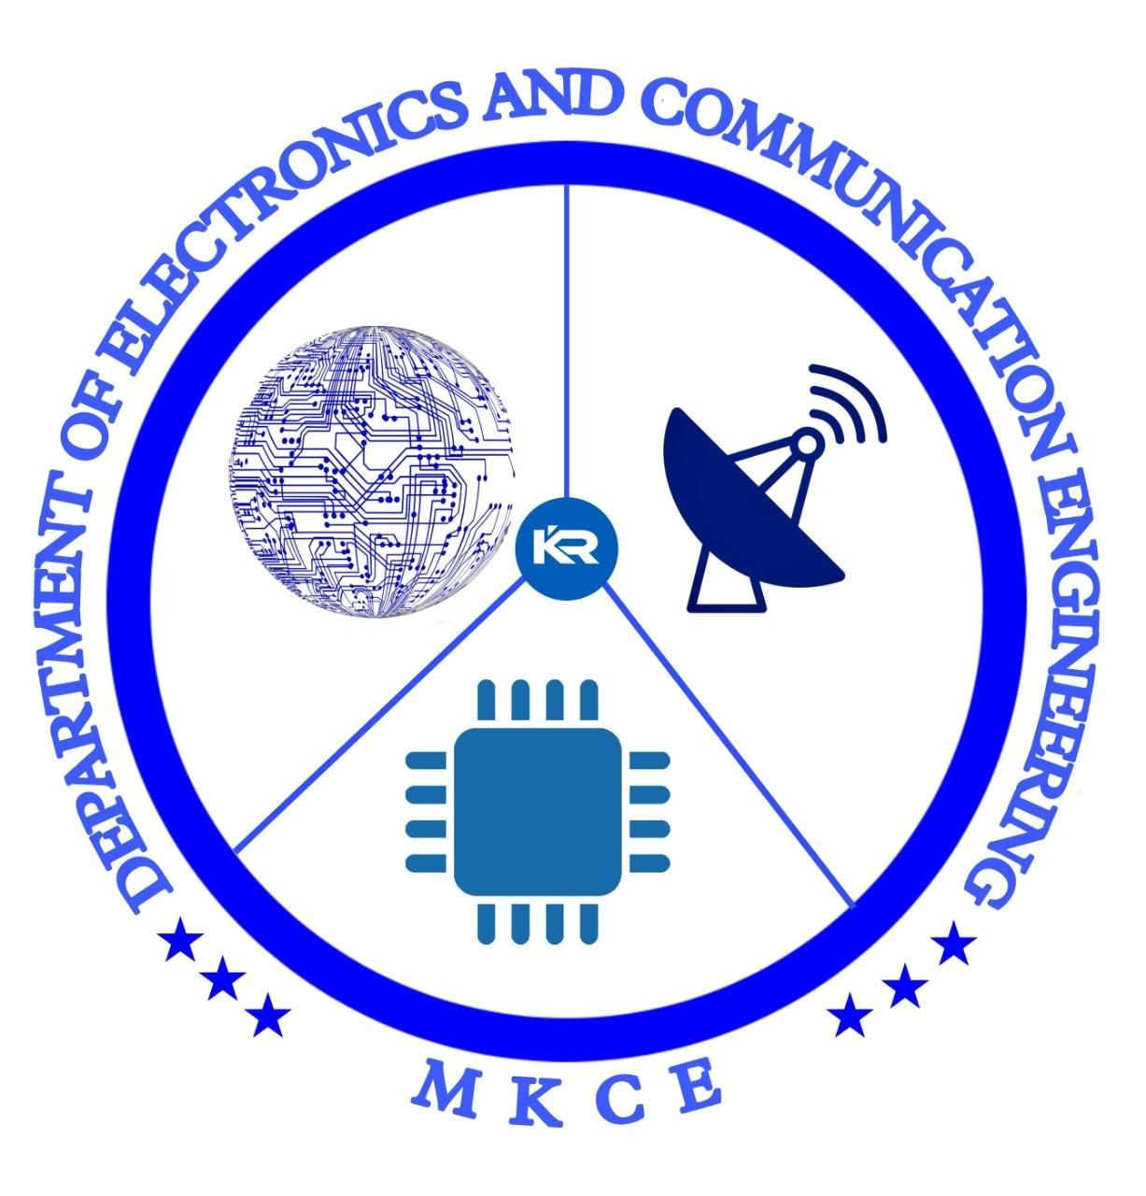


DEPARTMENT OF ELECTRONICS AND COMMUNICATION ENGINEERING
MINOR PROJECT REVIEW - IV
IOT ENABLED ENERGY METER
DATE:27.04.24
GUIDED BY: Dr.R.KALAIARASAN TEAM MEMBERS : B R SANJEEVADHARSH
S RANJITH
O PRAAVIN

Slide 2
Problem Statement
Real-time power measuring via the Internet is not available to users of traditional energy metres.
People are therefore ignorant of the amount of electricity used on a daily basis in their homes, and as a result, there is a power deficit worldwide.

Slide 3
Introduction
IoT
IoT is a system of interconnected computing devices that use internet protocols to communicate and transfer data. This allows remote devices to communicate amongst each other without the need for human involvement.

Slide 4
Objectives
1. Eliminates manual monthly meter readings.
2. Monitors the electric system much more quickly.
3. Makes it possible to use power resources more
efficiently.
4. Provides real-time data Analysis.
5. Enables dynamic pricing, which raises or lowers the cost of electricity based on demand.

Slide 5
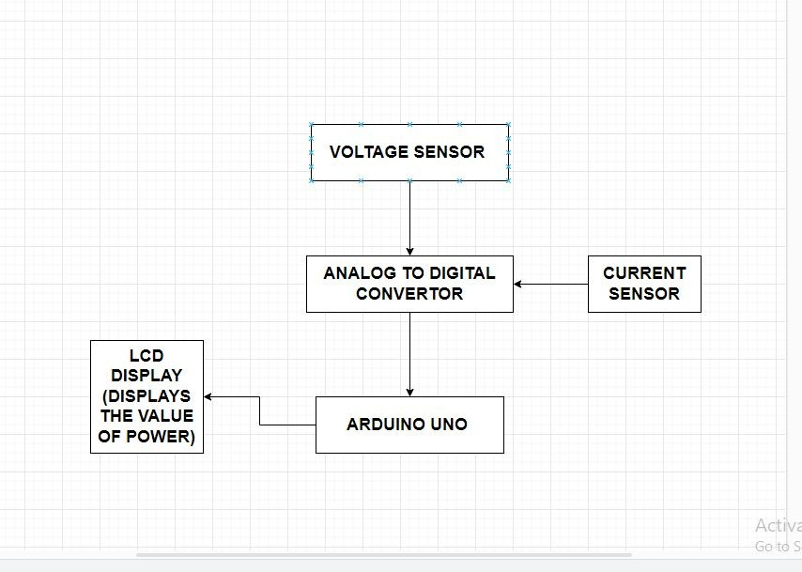
Existing System

Slide 6
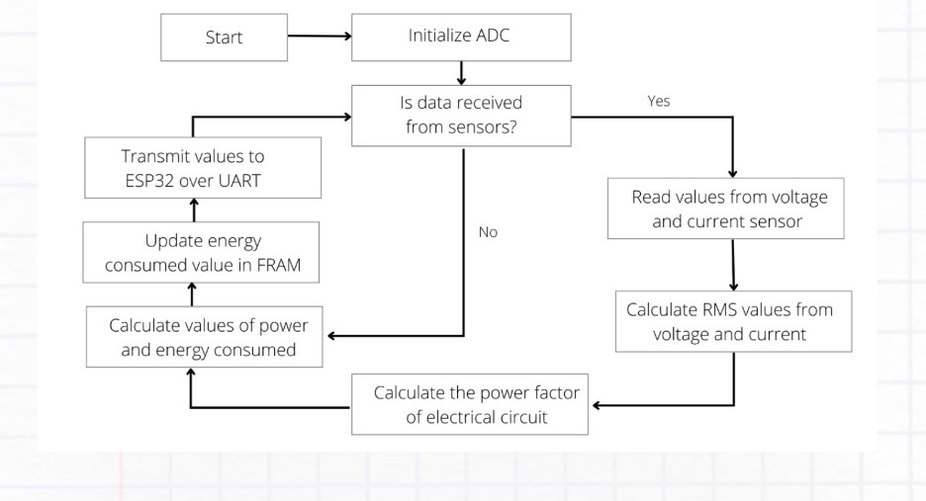
Proposed system

Slide 7
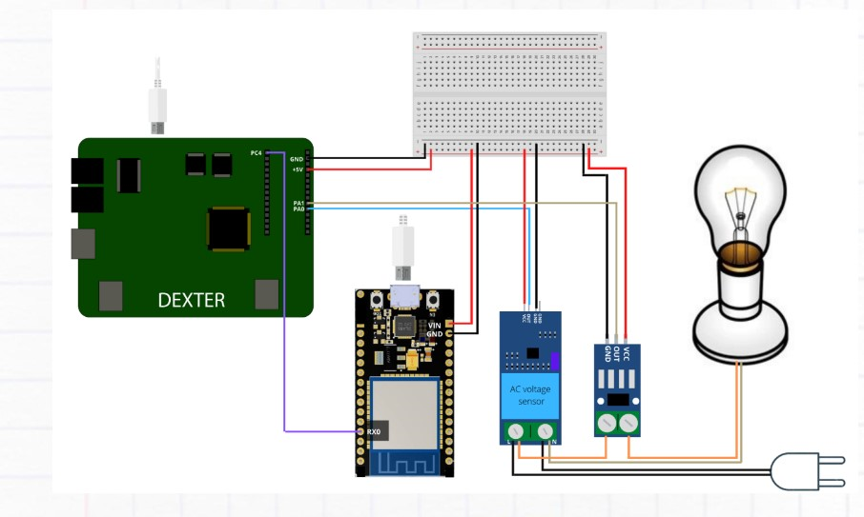
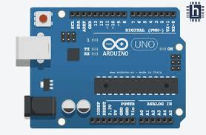

Slide 9
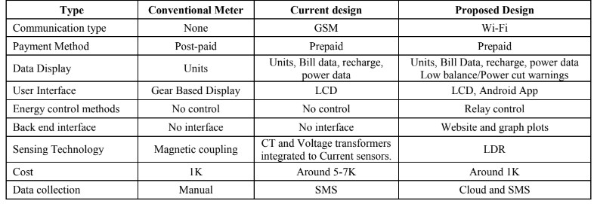
.

Slide 10
Features
1. The have a built in LCD for displaying the real-time
data.
2. They use ESP 32 WIFI Module for communicating the billing and
unit’s information to user and Power Company.
4. Displays real time units used/left, power consumed and
bill data.
5. CT and Voltage transformer interface for energy
calculations.

Slide 11
Addition features Integrated in Future:
IOT based monitoring on Think Speak Cloud using website and app.
Integration to the Smart Home.
One to many monitoring.

Slide 12
Conclusion
1.A sophisticated device that leverages the power of IOT Technology to revolutionize the way electricity is metered and managed.
2.By enabling real time communication and exchange,IOT electricity meters offer numerous benefits for both utility companies and consumers.
3.It connects objects and make them “talk to each other” and share information among themselves and use that information for actions.

Slide 13
References
Sahani, B., Ravi, T., Tamboli, A., & Pisal, R. (2017). IoT based smart energy meter. International Research Journal of Engineering and Technology (IRJET), 4(04), 96-102.
Barman, B. K., Yadav, S. N., Kumar, S., & Gope, S. (2018, June). IOT based smart energy meter for efficient energy utilization in smart grid. In 2018 2nd international conference on power, energy and environment: towards smart technology (ICEPE) (pp. 1-5). IEEE.
Saha, S., Mondal, S., Saha, A., & Purkait, P. (2018, December). Design and implementation of IoT based smart energy meter. In 2018 IEEE Applied Signal Processing Conference (ASPCON) (pp. 19-23). IEEE.
Chakravarthi, P. K., Yuvaraj, D., & Venkataramanan, V. (2022, April). IoT–based smart energy meter for smart grids. In 2022 6th international conference on devices, circuits and systems (ICDCS) (pp. 360-363). IEEE.
Kumar, L. A., Indragandhi, V., Selvamathi, R., Vijayakumar, V., Ravi, L., & Subramaniyaswamy, V. (2021). Design, power quality analysis, and implementation of smart energy meter using internet of things. Computers & Electrical Engineering, 93, 107203.

